Slide 1



IFMIS Evolution, Design Principles, and Challenges
MUKWENDE Placide
March 07 2025

Slide 2


Contents
Context
IFMIS Business Evolution
IFMIS Technology Evolution
Architecture Components
IFMIS Design Philosophy
Development Dimensions and Design Principles
Challenges
Key Insights and Food for Thought

Slide 3
I –Integrated (Split and Merge)
F – Finance (Public: Revenue, Expenditure, Debt, Administration)
M – Management (Operation vs Strategic)
I – Information (Manual: Paper-based → Digital: Paperless)
S – System (Automation: Users + Computer Programs + Hardware)
Context: What? and Why?

Slide 4
Business Context – IFMIS is an Evolving Set of PFM Policies
REVENUES
CORE = BUDGET + TREASURY
EXPENDITURES
Government Revenue
(Tax & non-tax)
Budget Planning
Budget Formulation
Salaries and Wages
Acquisition of Goods, Works & Services
Budget Authorization
Commitment of Funds
Cash Forecasting
Grants
Travel Management
Receipt
Payment
Accounting
Reporting
Public Investment Projects
Debts
Other Expenditures
An Integrated Financial Management Information System (IFMIS) is a digital platform that helps governments manage and track public money efficiently and transparently to enhance accountability. It ensures funds are spent as planned, reduces fraud, and provides real-time financial data for better decision-making.

Slide 5
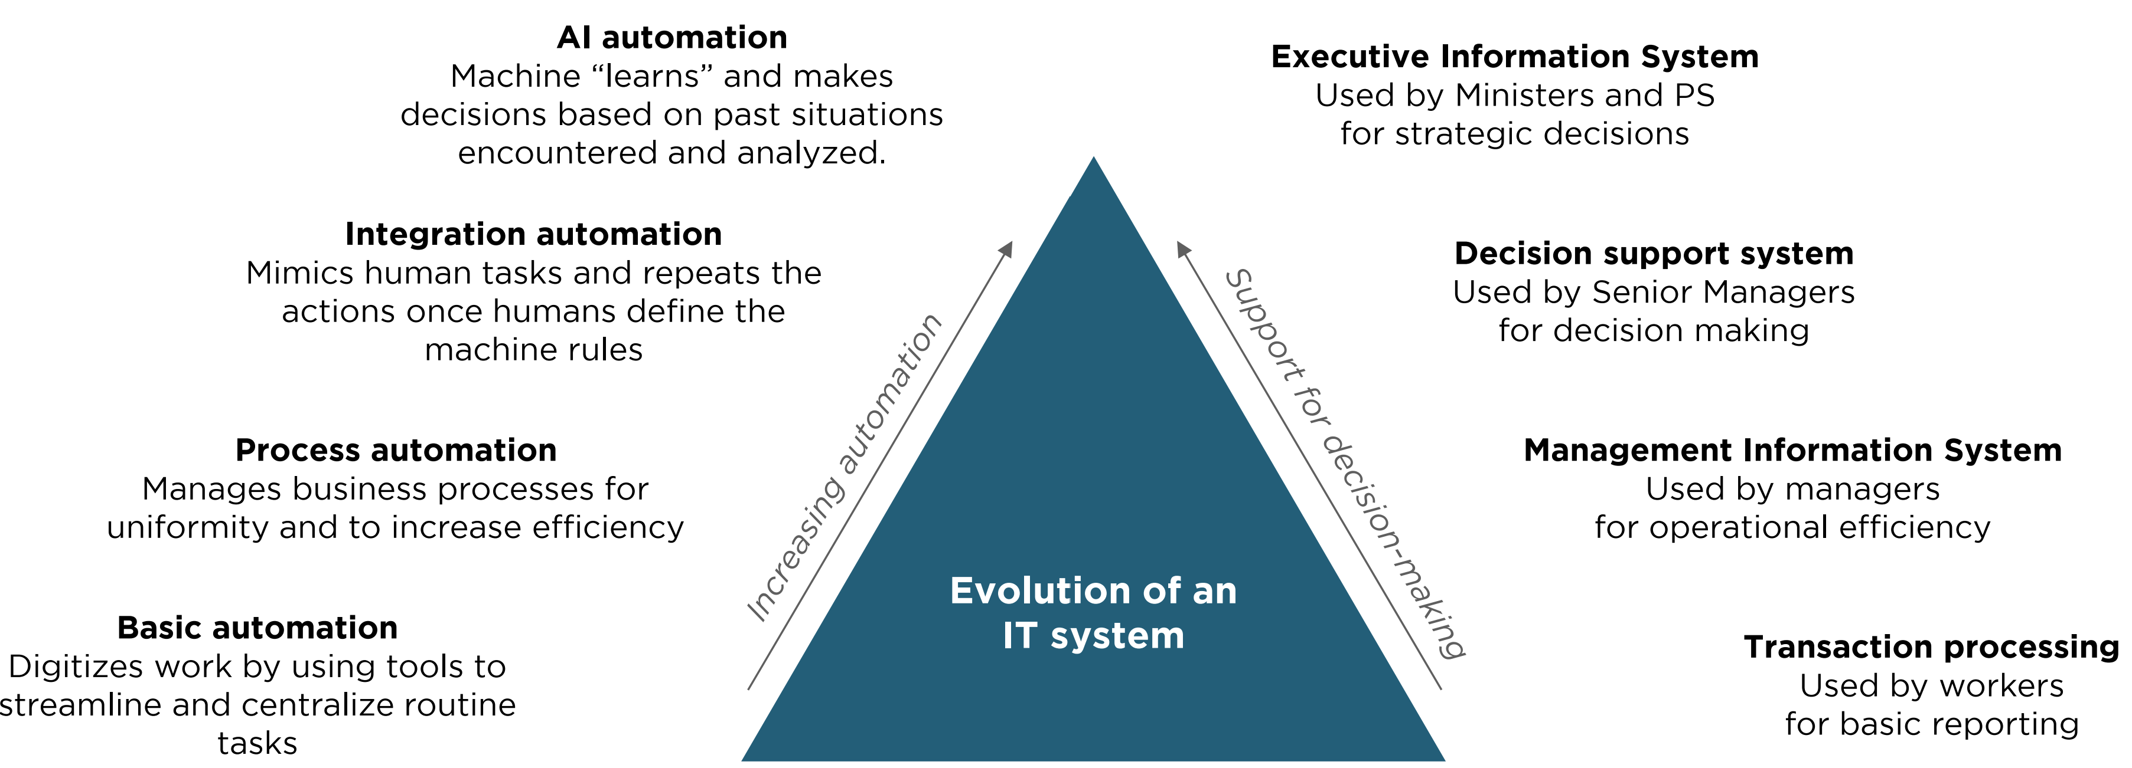
Technology Context – IFMIS is an Evolving IT System
Evolution of IFMIS as an IT System
IFMIS is an evolving IT system as the complexity of its functions move up the value chain of automation and support for decision-making.

Slide 6
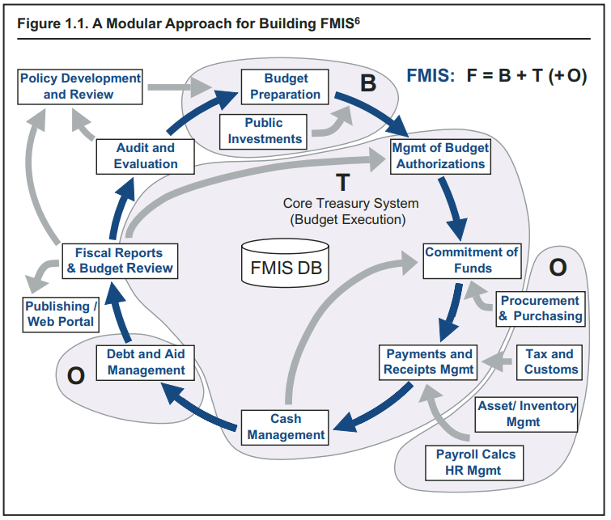
IFMIS Architecture Components
Source: World Bank

Slide 7
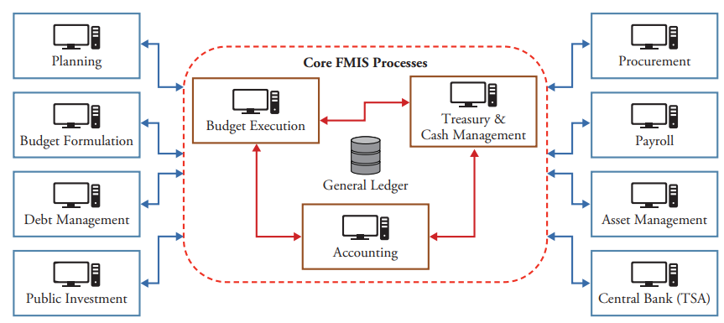
IFMIS Architecture Components
Source: IMF

Slide 8
IFMIS Design Philosophy
IFMIS
G2C
G2E
G2G
G2B
e-Government is about using technology (mainly the internet and ICT) to provide government services to citizens, businesses, and other arms of the government.
Digital service delivery reduces inefficiencies in public service delivery, increases accountability and reduces corruption through transparency, and empowers the citizen or business through access to information and services they need anywhere, anytime, resulting in effective and efficient government.
E-Government
Government to
Citizens
Government to
Employees
Government to
Government
Government to
Business

Slide 9
IFMIS Development Dimensions and Design Principles
Oracle
Java
Conway's Law: The way members of an organization communicate and collaborate will shape the design and character of the systems and projects it produces.
First Law of Software Architecture: Everything in software architecture is a trade-off.
CAP Theorem: Any distributed information system can provide only two of the following three guarantees: Consistency, Availability, and Partition tolerance.
Design by Committee: A camel is a horse designed by a committee
Conceptual Integrity: It is a dictatorship, not a democracy.
Data Scientist
Cisco
AI
ML
IPSAS
PBB
Tools (Technologies)
Model
Blockchain
RBM
Cybersecurity
PostgreSQL
C#
Processes (PFM Policies)
CPA
People (PFM Users)
DevOps Engineer
CBM
API
UML
Budget Controller
Chief Accountant
Climate Budget Tagging
AG
Planner
Cash Accounting
Accrual Accounting
Gender Budget Tagging

Slide 10
Challenges and Opportunities
Political will is key to IFMIS success because it drives the commitment, resources, and enforcement needed to implement, sustain, and safeguard the system against resistance, corruption, and inefficiencies.
External dependencies that may not allow to move to the required speed, and results in very high IFMIS acquisition and maintenance cost.
Skill gaps in technology and policies: The illusion of explanatory depth (IOED) is a cognitive bias where people believe that they understand a topic much better than they actually do.
IFMIS ownership and coordination between institutions are key challenges to IFMIS because multiple government entities with overlapping roles often compete for control, leading to fragmented decision-making, inconsistent data sharing, resistance to standardized processes, and lack of accountability, all of which undermine the system’s effectiveness and sustainability.

Slide 11
Key Insights and Food of Thoughts
ECOSYSTEM
Value Realization
01.
03.
Build an IFMIS ecosystem, not an egosystem
Design IFMIS as a value realization tool: efficiency, accountability, transparency, cashless, paperless, etc.
Change is Constant
OpenIFMIS
02.
04.
Building IFMIS as an open source software can help Africans to build strong knowledge sharing, reduce IFMIS cost, and adopt IPSAS more consistently.
The ability to adapt IFMIS to new changes is the key success factor.

Slide 12
Thank You

